Slide 1

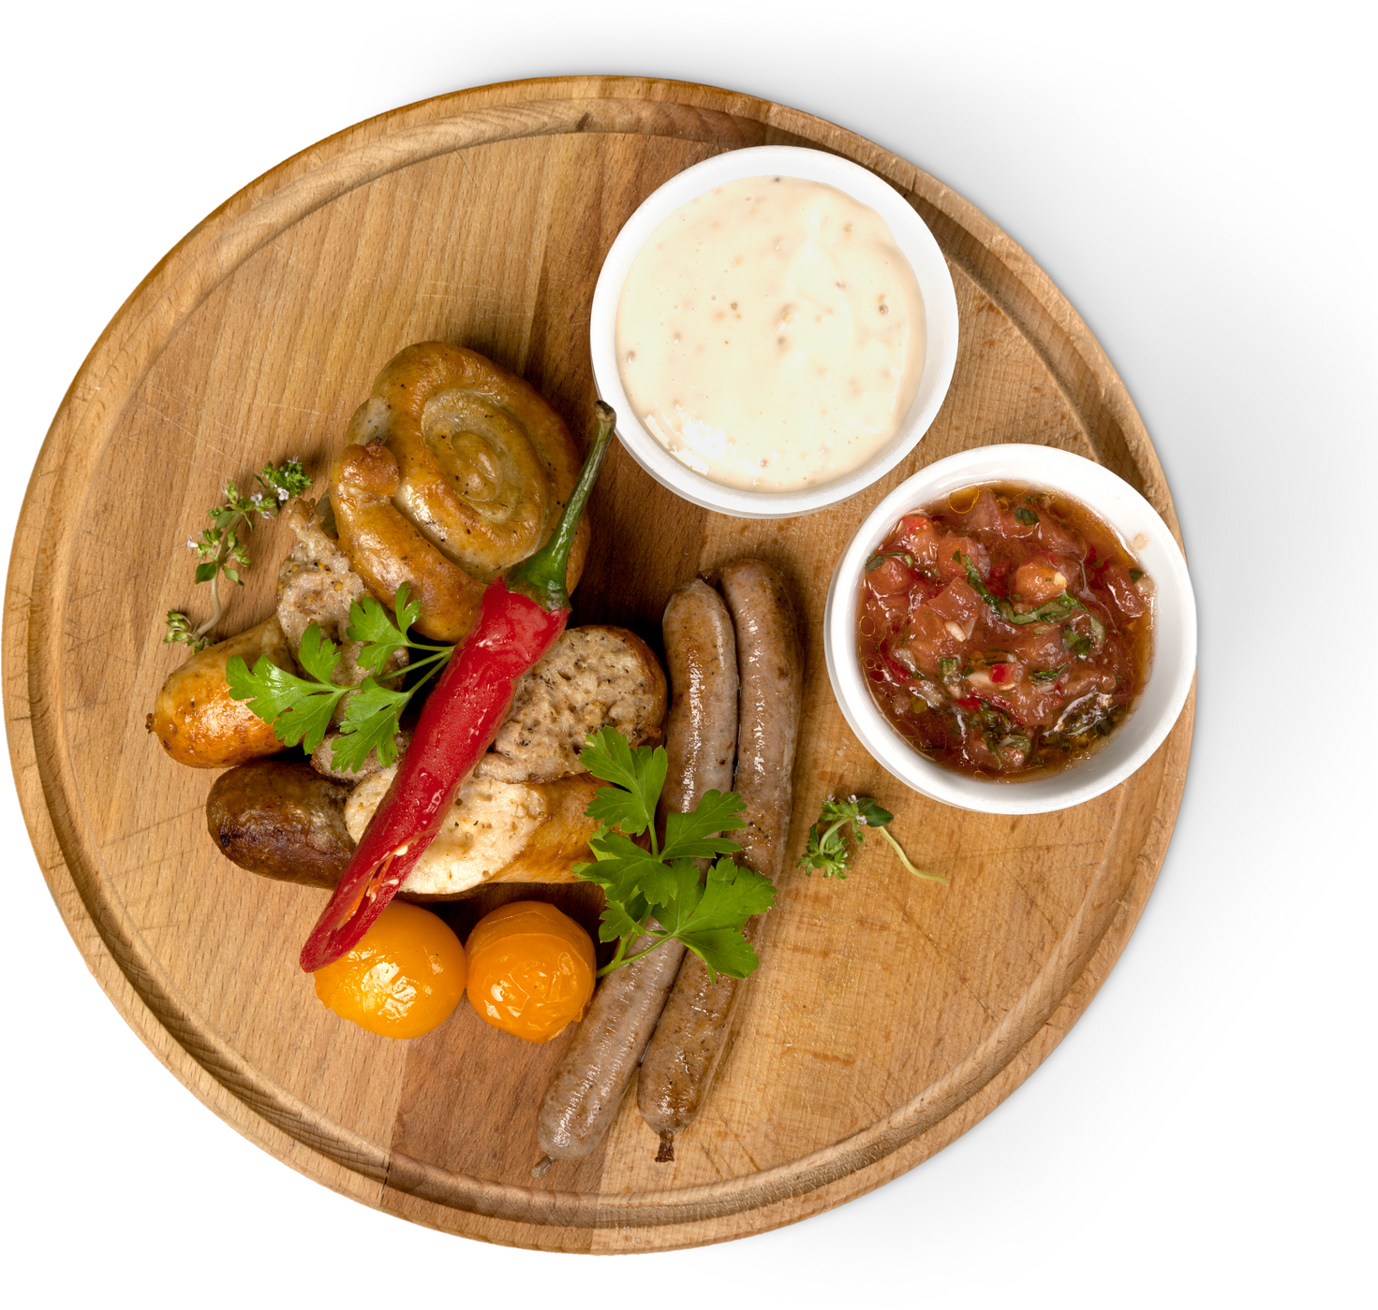
Research Project Presentation
Efficient Supply chain Strategy for F&B chains in South East Asia
Navigating the Digital Shift: Examining Upselling Ability in
the restaurant industry amidst online food delivery Growth
Start Slide
PRESENT BY: SHI JINGWEN

Slide 2
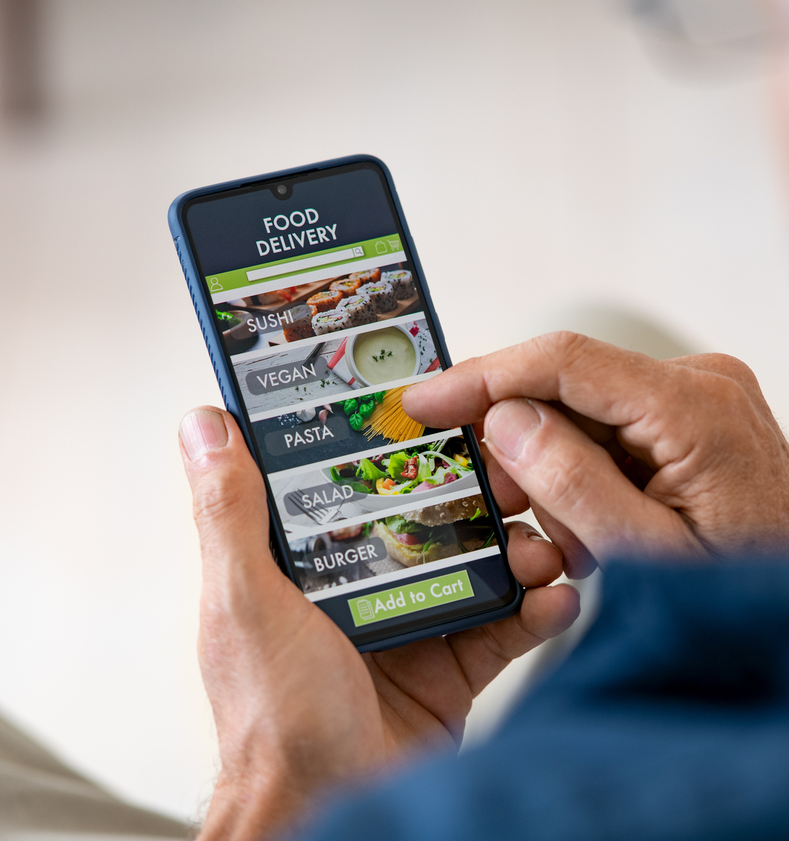
Presentstion
Agenda
Industiral Overview
Literature Review
Problem Statement
Dataset Description
Variable Construction
Model Fitting
Results Interpretation
Moderator Analysis
Study Findings
Mgmt Implementation
Research Limitations and Future Investigations
03
04
06
07
08
08
10
11
13
13
14

Slide 3
Restuarant Industry Overview
The Rise of Online Food Delivery Platforms
Demand of Convenience
Technology Advancement
Market Competition
COVID-19 as a Catalyst
Safety of Online ordering
Variety of Choices
Reshaped dining habits in the long term
Traditional Restaurant
i.e. dine-in, take away
OFD Platform
In 2023, surpassed
$1 Trillion
in market size

Slide 4
Literature Review
Key findings:
01
OFD Convenience comes at a Price: While it has facilitated restaurants in reaching a wider customer base and fostering market presence, commission fees charged that can escalate to 30% per order.
Fill the gaps ...
02
Problem Statement
OFD’s long-term contribution to profitability is disputable, given the razor-thin market nature and fastly growing and saturated industry.
Investigating the Impacts of OFD platforms’ dependence on Restuarant’s Upselling Capabiity
03
Need for strategic adaptation in customer engagement and sales tactics. Amidst these changes, upsell is considered as one of the most efficient strategy has remained a cornerstone for restaurant profitability.
04
UPSELLING - refers to a sales technique aimed at encouraging customers to purchase additional items or higher-priced alternatives. The opinions on the impacts of OFD reliance on upselling capability is also contradictory.

Slide 5
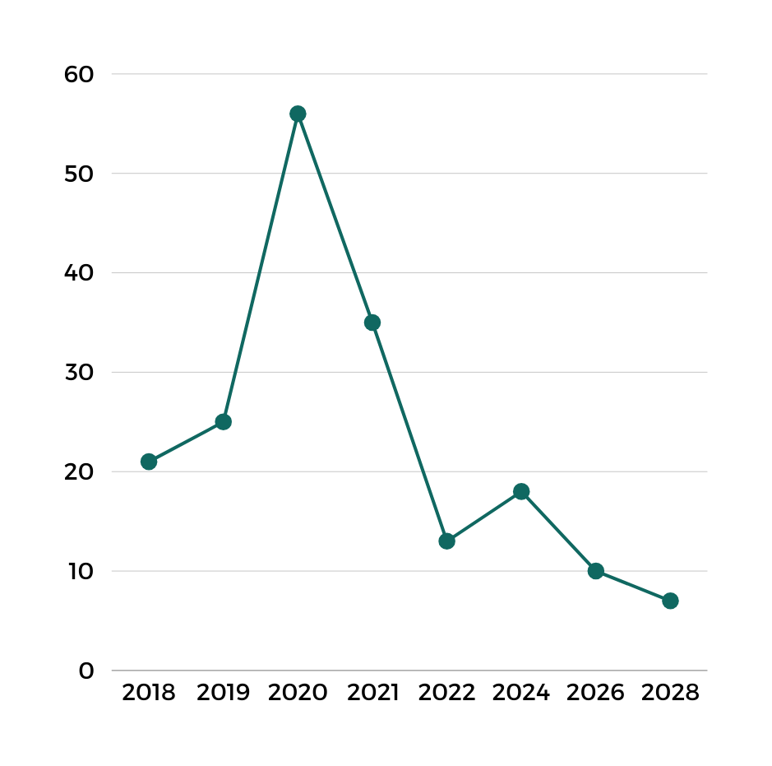
Revenue %Change of the Global OFD Market, 2018-2028
The long-term contribution of OFD platforms to profitability remains debatable:
Pre-COVID: 21% in 2018;
COVID-19 Outbreak: Peak at 2020, hitting 56% growth rate;
Post-Covid: continued positive trend but at a much slower pace, (slower than pre-covid era), hitting as low as 7% in 2028
Statistic Source: https://ecommercedb.com/insights/leading-companies-in-the-online-food-delivery-market-by-region/4464

Slide 6
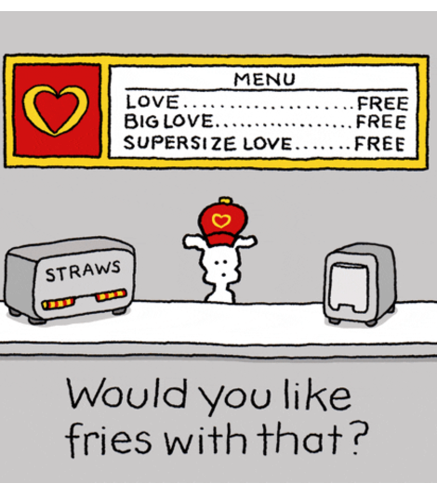
Hypothesis Developement
Contrary Perspectives
Digital environments may lower price sensitivity, and online tools excel in automatically presenting personalised recommendations and add-ons.
[H0] Increased dependence on third-party OFD platforms contributes to an enhanced upselling ability.
Consumers’ scepticism about food quality during delivery and the absence of inter-personal interaction may deter customers from indulging in add-ons or premium items.
[H1] Increased dependence on third-party OFD platforms deteriorates restaurants’ upselling ability.

Slide 7
Dataset Description
Number of Transactions: 5o millions
Timeframe: Jan 2018 - Dec 2018
Sourced from: 99 Quick-Service Restaurants (QSRs) across the nation
Number of Rows: 32,695 data points on a restaurant-day basis
Column Variables
Applicable promotions
Bundle deals
Upselling involved?
Promotion duration
Dine-in (51%)
Take-away (28%)
Drive-through (6%)
OFD platforms (4%)
Sale number of SKU
Sale price of SKU
Sale time

Slide 8
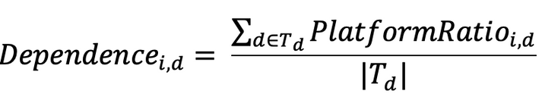
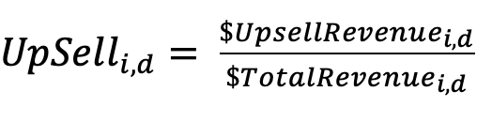
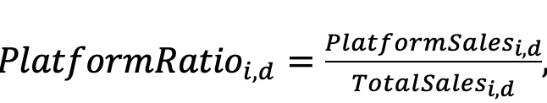
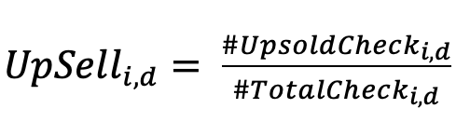
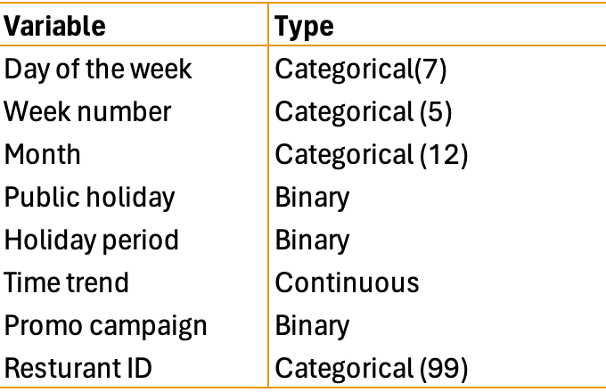
Variable Constructions & Model Fitting
Independent Variable:
14-day Platform Dependency
Key dependent Variable: Upsell Capability
Upsell Capability
Other Controlled Variables X(i,d)

Slide 9
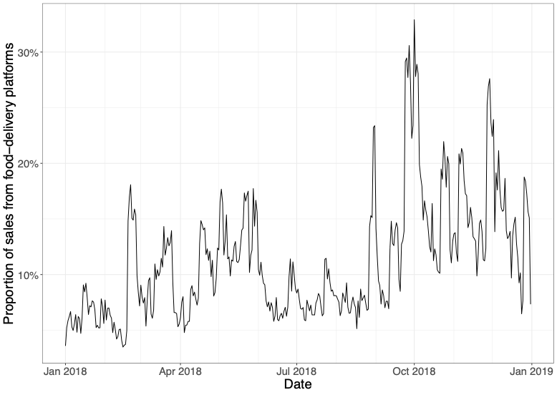
Median PlatformRatio(i,d) through out Year 2018
Fluctuating trends with several peaks and troughs;
A band of approximately 10% to just over 30%;
Significant swings in the ratio indicate that the QSR's reliance on platforms is not constant but rather responsive to external or operational influences.

Slide 10
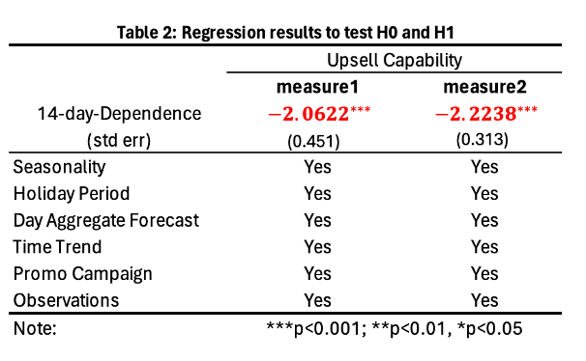
Regression Results Interpretation
IF increase dependence by 10%:
=> 18.63% reduction in upselling revenue (measure1);
=> 20.05% reduction in upsold transactions (measure2);
=> Reject H0.
Key finding: an increased reliance on 3rd-party OFD platforms is linked to a discernible deterioration in a restaurant's ability to upsell.

Slide 11


MODERATORS
...
CoreMenu Rev
/
#CoreMenu Order
#of CoreMenu item
ordered
(each transection)
#(lunch)Transaction
/
#(dinner)Transaction
Party Composition
Party Size
Peak Mealtime Distribution
Various customer’s traits such as age, gender, affluence, and ethnic background, etc.
Use Affluence Level in this case
Number of customers seated together at one table, with certain restaurants attracting larger groups, while others cater to a more personal dining experience.
How customer demand spreads throughout the day. Some stores experiencing rushes during lunch hours but quieter dinners, and others maintaining a steady flow during both major mealtimes.

Slide 12
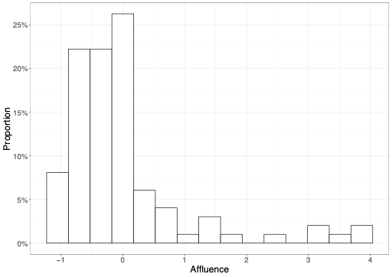
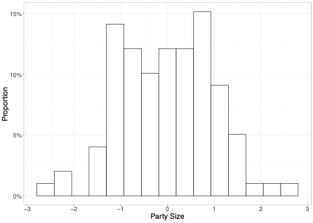
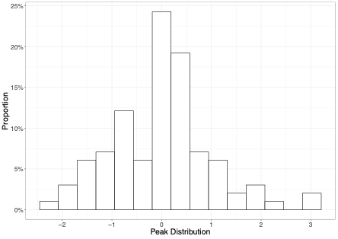
MODERATORS
Party Composition
Party Size
Peak Mealtime Distribution

Slide 13
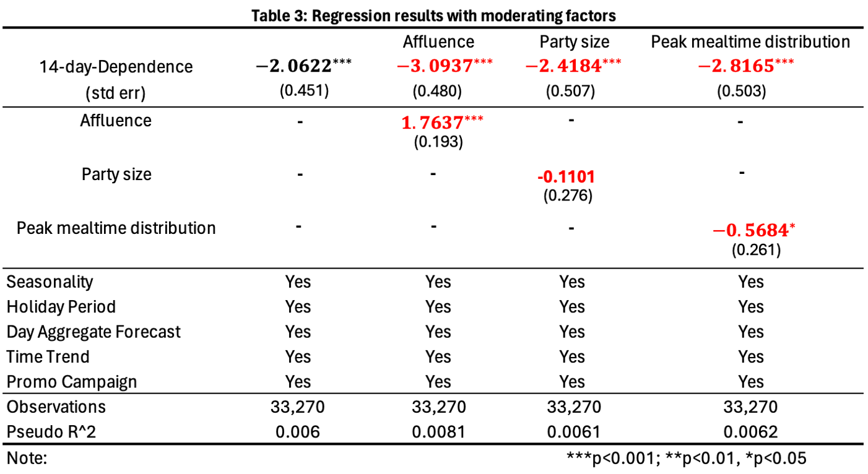

Regression Results Interpretation (with moderators)
Affluence Level: statistically significant amplifying affect;
Party Size: not a statistically significant factor;
Mealtime Distribution: lunch rush-hour stores are more vulnerable to the adverse impact on upselling ability

Slide 14

Transforming challenges into opportunities
Focus on more affluent customer segments: tailor their online offerings and marketing efforts, emphasising quality and exclusivity that align with their higher spending power
Understanding the ebb and flow of customer traffic: deploy targeted marketing and promotions during these peak times
Managerial
Implementations

Slide 15
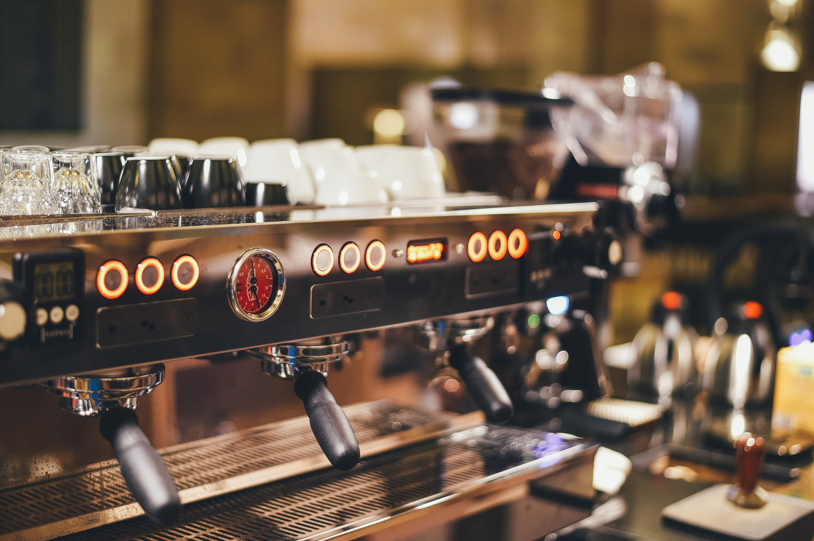


Reseach Limitations:
Used data from just one QSR chain, so findings might not apply to all restaurant types or global markets;
Limited data restricted the analysis of certain customer traits;
While attempts were made to control for external factors like weather and events, some residual effects might still influence the study's conclusions.
Steps Forward:
Include more restaurant types and locations to confirm if the findings apply universally;
Additional studies on customer traits and other factors could deepen understanding of upselling strategies;
There is a need for experimental or long-term studies to better understand causality and the lasting impacts of OFD platform dependence on restaurant profitability.

Slide 16
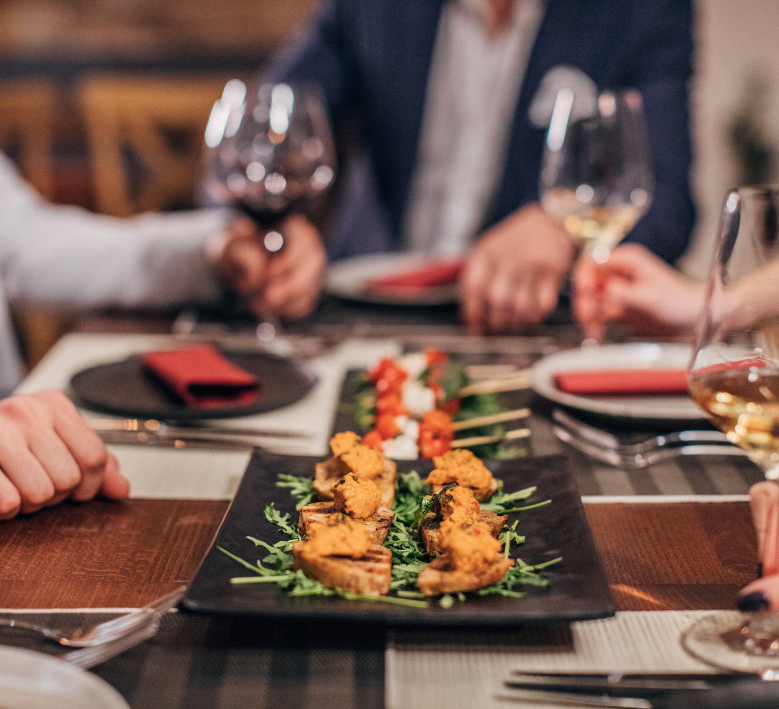
PRESENTATION 2024
THANK YOU
FOR ALL ATTENTION

